Slide 1
New to Year 4
Welcome!

Slide 2
Staffing
Teachers
Mr Edwards - Mon ,Tue ,Weds (am)
Mrs Todiresei - Weds, Thurs, Fri
Teaching Assistants
Mrs Bushby
Miss Roberts

Slide 3
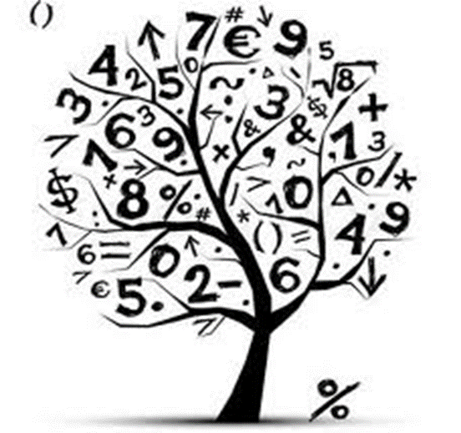
Maths
Including:
Place value, rounding, written addition and subtraction, counting in multiples, dividing by 10 and 100
Building towards times table fluency to x12 - times table grids
Multiplications Tables Check in June
Useful resources for tables: ‘Hit the button’; timestables.co.uk

Slide 4

Literacy
Including:
Descriptive writing, poetry writing, building vocabulary, reading and performing, discussion texts
Spelling - with lessons, along with discrete sessions
Guided Reading Class Book: The BFG

Slide 5
Literacy - some key skills
create settings, characters and plot in narrative
use speech punctuation correctly most of the time
Use a range of sentences and explore the ordering of words
use a range of conjunctions, nouns and adverbs
use past and present tenses correctly
use the range of punctuation mostly correctly (e.g. commas; use of apostrophe)
spell most words correctly from previous learning and Y3/4 spelling list; beginning to use a dictionary to check spellings
write legibly, paying attention to size and spacing; maintain the use of joined handwriting in independent writing.

Slide 6
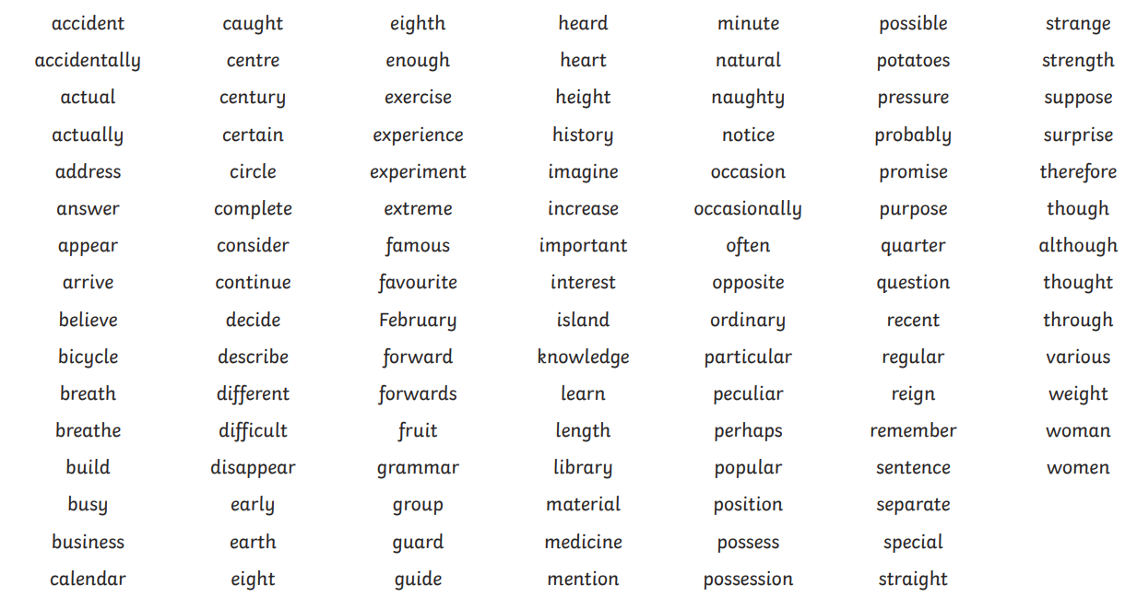

Slide 7
Science - Living Things; Animals, including humans
The digestive system in human and animals; the functions of teeth. Learning about herbivores, carnivores and omnivores in the context of teeth, digestion and the food chain. Extending our understanding of food chains to more complex chains and food webs.
Exploring different animals’ habitat (Grassland; Ocean; Desert; Woodland; Coastal; Jungle)

Slide 8

Foundation subjects
Computing - how networks function; editing media
Geography - earthquakes and volcanoes (first half term) Europe with a focus on Italy (second half term)
RE - Where do we belong? What is a God and why do some people believe in God/Gods?
PSHE - friendships, recognising risks online and respecting differences
Music - ukulele lessons (Tues am)
Art/DT - sculpture linking to Geography & Cooking
PE - Ball skills and gymnastics (first half term) Tri-golf and Dance (second half term) (Mon & Thurs pm)
French - Where in the world speaks French? Numbers, My family

Slide 9

Reading
Children should have a reading book at school and one at home
Reading records - checked on Thursdays
Ideally read at home at least 3x a week for approximately 10 minutes

Slide 10

Trips
You should have received an email today about the school trip booked to the Natural History Museum.
Thursday 12th October
Coach will be leaving school at 8:45
11:30 - Emergency Earthquakes and Volcano show where they will make a real volcano and pour lava.
12:30 - Children will require a packed lunch and a bottle of water.
Time to walk around and explore the museum - a focus on the earthquake and volcano section where they can experience what an earthquake might feel like and see the effects.
They can bring a maximum of £5 to spend in the shop.
We will be collected at 3pm and will aim to return back to school for pick up at 4pm. This is of course traffic dependent.

Slide 11
Homework and Communication
Homework
Homework via google classroom
Reading with your child regularly and questioning their understanding is very beneficial
Please access the Mathletics units - they will be made available as they are taught
Communication
Do get in touch if we can help with anything
Grab us in the morning or after school for a quick word
Our door is always open!

Slide 12

Any questions?
Please note
Year 4: Google classroom code is hlrasfa

